Slide 1


COST AND PROFITABILITY OPTIMIZATION IN FOOD DELIVERY

Slide 2


Content
01
Problem Statement
02
Dataset
03
Process
04
Task
05
Results
06
Summary

Slide 3


Problem Statement
The food delivery service is struggling to achieve profitability, facing challenges across its operations. The company seeks a comprehensive evaluation to optimize cost and profitability, aiming to identify opportunities for cost reduction, revenue enhancement, and the implementation of effective pricing or commission strategies.
The analysis will focus on examining all costs associated with delivering food orders, including direct expenses like delivery fees and packaging, as well as indirect expenses like customer discounts and restaurant commission fees. The goal is to provide insights into the service's profitability on a per-order basis and to develop strategies to improve financial performance.

Slide 4
DataSet
The dataset contains comprehensive details on food orders,
1.Order ID
2.Customer ID
3.Restaurant ID
4.Order and Delivery Date and Time
5.Order Value
6.Delivery Fee
7.Payment Method
8.Discounts and Offers
9.Commission Fee
10.Payment Processing Fee
11.Refunds/Chargebacks.

Slide 5


PROCESS:
01
02
03
04
Feature Extraction
Cost Breakdown
Data Collection
Data Cleaning

Slide 6
PROCESS:
05
06
07
08
Revenue Calculation
Profit Calculation
Strategic Recommendations
Impact Simulation

Slide 7
TASK
1.COMPREHENSIVE COST EVALUATION:
2.ASSESSMENT OF PROFITABILITY
Identifying the major cost components associated with delivering food orders, including direct costs like delivery fees and indirect costs like discounts and payment processing fees.
Calculating the profitability of individual orders and aggregating this data to assess overall profitability. This involves examining how revenue generated from commission fees measures against the total costs.
3.STRATEGIC IMPROVEMENT SUGGESTIONS:
4.SIMULATION OF STRATEGY IMPACT:
Based on the cost and profitability analysis, identifying actionable strategies to reduce costs, adjust pricing, commission fees, and discount strategies to improve profitability. This includes finding a “sweet spot” for commission and discount percentages that ensures profitability across orders.
Simulating the financial impact of the recommended strategies on profitability, using the dataset to forecast how adjustments in commission rates and discount strategies could potentially transform current losses into profits.

Slide 8
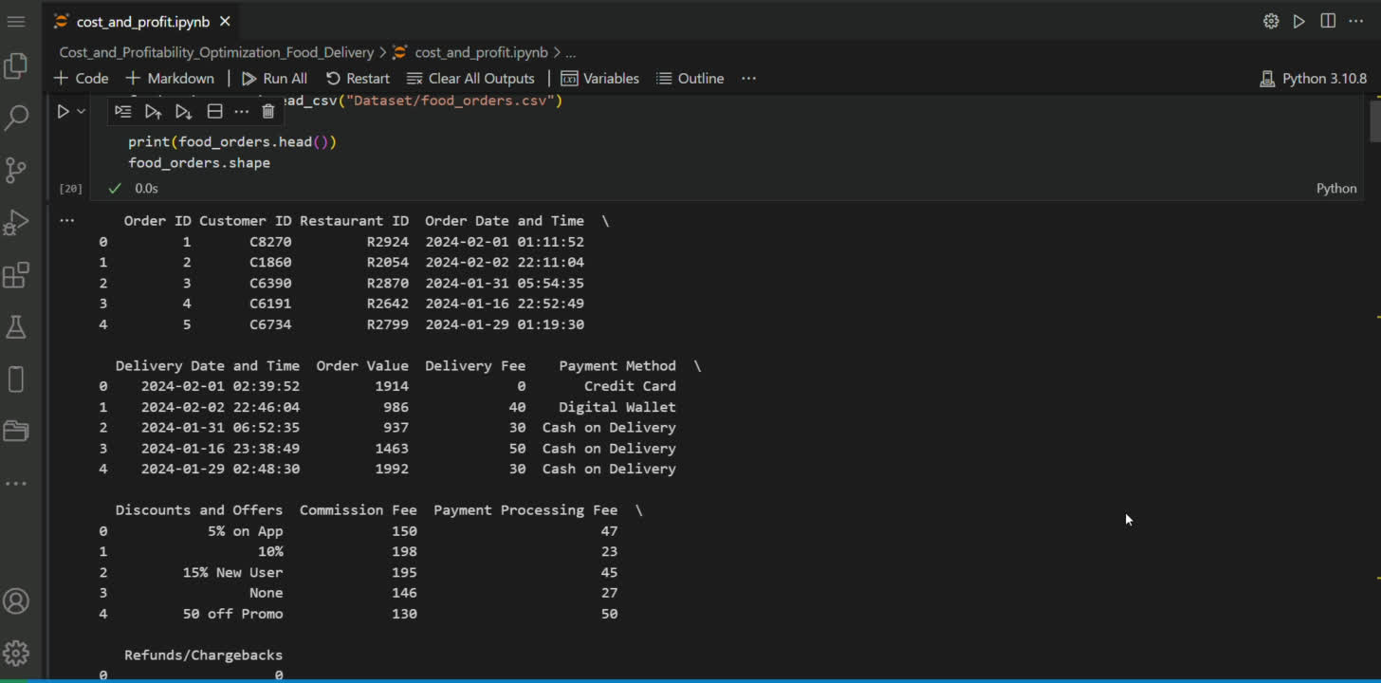
RESult:

Slide 9
Analyzing the cost and profitability of a food delivery company involves a comprehensive examination of all expenses related to delivering food orders. This encompasses direct costs such as delivery fees and packaging, as well as indirect expenses like customer discounts and restaurant commission fees. By comparing these costs against the revenue generated, primarily through order values and commission fees, the analysis aims to provide insights into the service's profitability per order.
SUMMARY:

Slide 10
Thank you!
amithaamitha816@gmail.com

